Slide 1
Intern Exit
Presentation
Chengming Li

Slide 2
Agenda
About Me & Future Journey
Accomplished Projects
Key takeaways
Acknowledgment
Q&A
Notes:
Today’s Agenda:
No elaboration

Slide 3
About me
Chengming(Steven) Li
BS Electrical & Computer Engineering Degree at University of Colorado, Boulder
Will be MS Electrical & Computer Engineering Student at University of California, San Diego
Here, at Eridan, RF Test Engineering Intern
Notes:
My background
BS, MS RF Test Engineering Intern
What am I doing here? What’s my project? And how that goes?

Slide 4

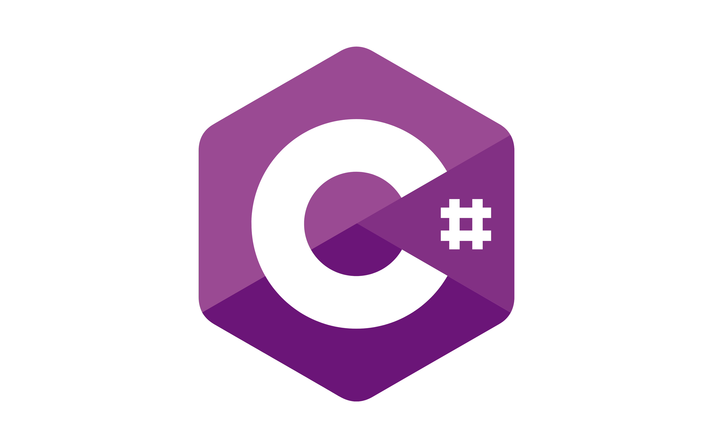

Accomplished Projects
pyEridanLab
The Problem? Why?
Cost of MATLAB License
Transition from C# to Python
How to use DLLs in Python
Notes:
A repo is used to convert MATLAB code to Python
Why we need that? How we do that?
Matlab License
Expensive but python and C# are free
C# to Python
How to avoid recreating
DLL
How to use it?
Do we find the solution?

Slide 5
Accomplished Projects
pyEridanLab
The Solution -> How !?:
Cost of MATLAB License
Use C# and Python.
Open source,
Free to use.
Transition From C# to Python
Use Dynamic Link Library (DLL)
.Net
pythonnet
How to use DLLs in python
Type hint files, .pyi
Import clr
Notes:
Solution:

Slide 6
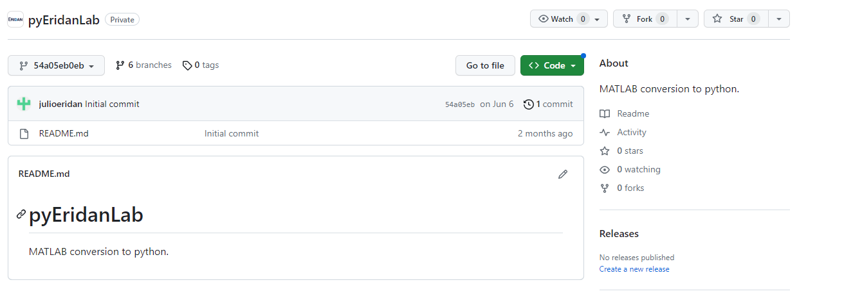
Accomplished Projects
pyEridanLab
What it looks like at the beginning
Notes:
What it looked like on the second day of my intern

Slide 7
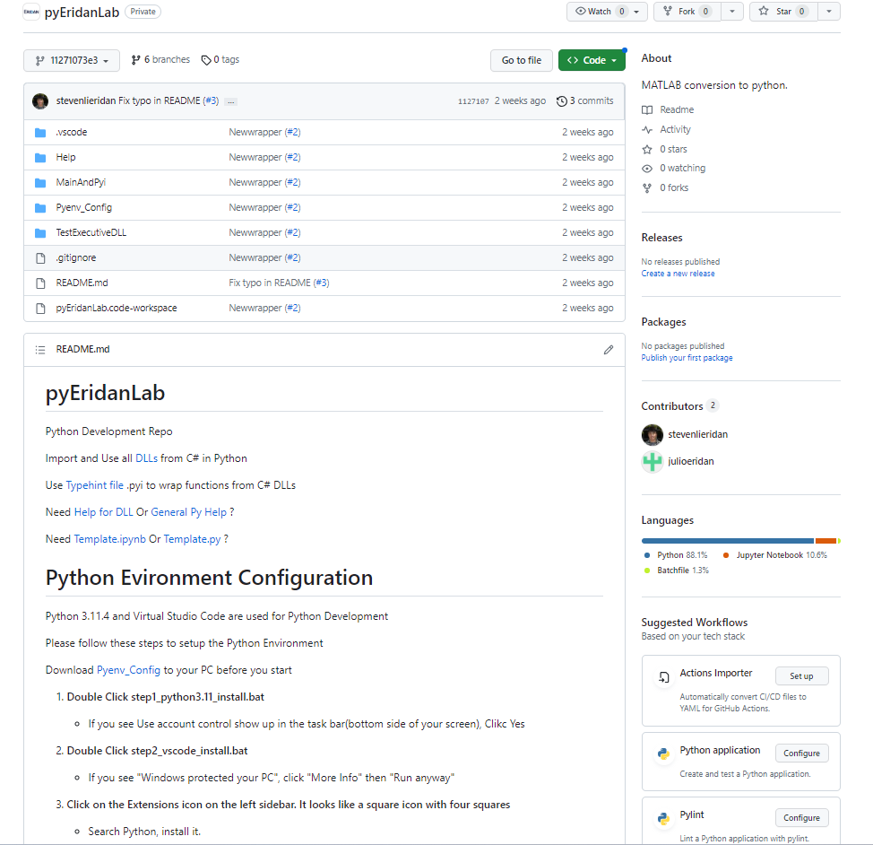
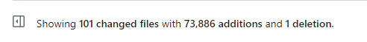
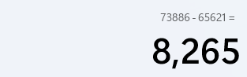
Accomplished Projects
pyEridanLab
After a month effort…
Ignore 65621 additions, which are dlls
8265 lines of code, wrap everything from C#
Notes:
After a month effort
With around 8000 lines of code, it wrap everything we have so far from C#
This is what repo looked like
More readme
More code
More auto-installation

Slide 8
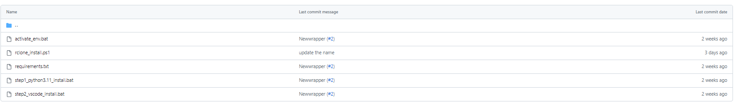
Accomplished Projects
pyEridanLab
Double click to install everything as you need
Notes:
Semi-Auto install the python, vscode and rclone as you need
Just double click, no further steps are needed
Beyond that, may wonder the usage of this repo, how to use python?, How to use DLL?

Slide 9
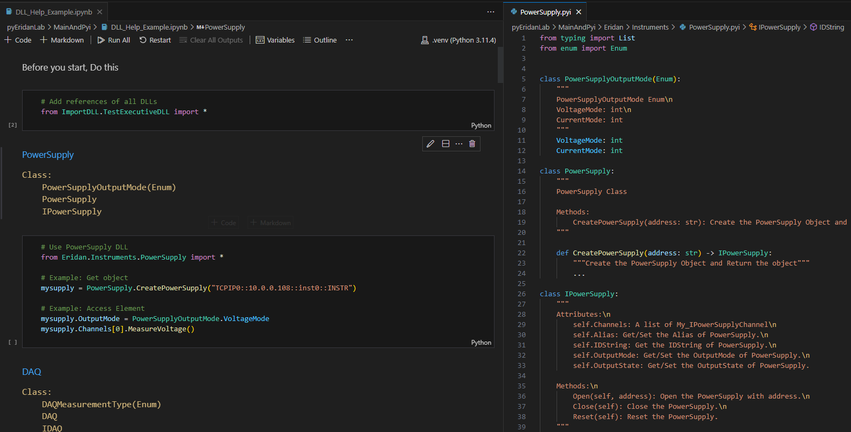
Accomplished Projects
pyEridanLab
Need help for DLLs usage? --> DLL Help Script!
Notes:
DLL Help Script
How about python help?

Slide 10
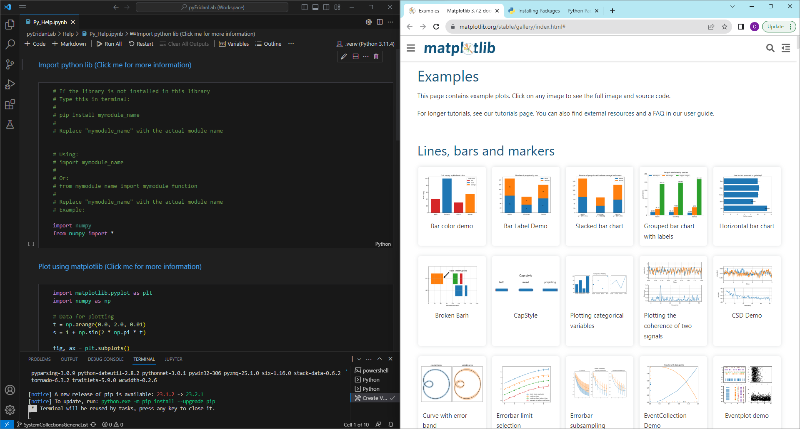
Accomplished Projects
pyEridanLab
Need help for Python usage? --> Python Help Script!
Notes:
Python Help script
Double click text in blue, it’s a hyperlink to the online resource, or the raw script
Tried to put as many as I can to improve end-user experience
So it’s easy to use and to understand. And I also want to make sure there is not many confusions from the people as they start this repo
After I leave, how to do the maintenance? How to keep the repo in the safe condition?

Slide 11
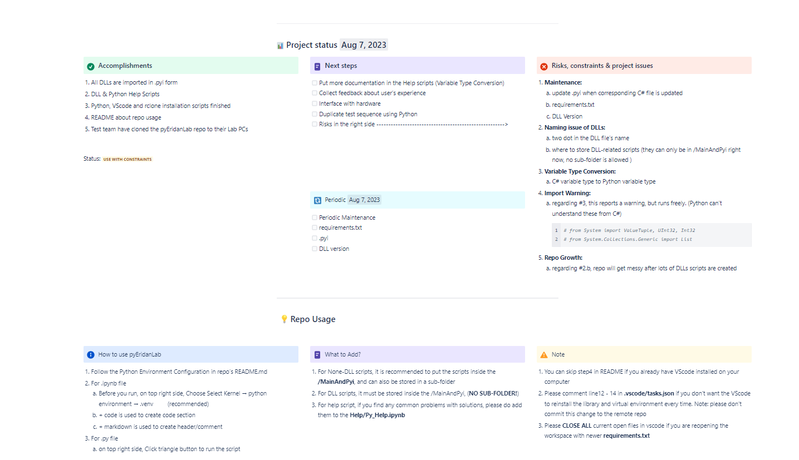
Accomplished Projects
pyEridanLab
Hands off? --> Confluence Page
Notes:
Hands-off document on confluence
This is my first project
Let’s move to the second project

Slide 12
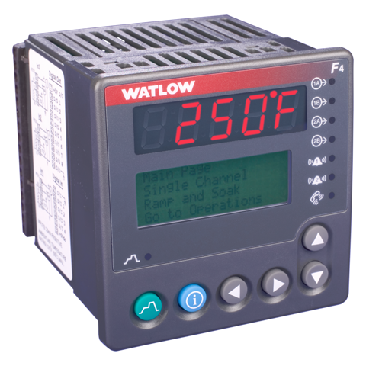
Accomplished Projects
2. Temperature Chamber
The Problem? Why?
Oscillation during the heating/cooling
How to know if there is an error in 30s
Whether the hardware switch is on
Whether it is going to the right direction
How to handle the overshooting
Notes:
What’s the problem?
Oscillation
Edge cases
overshooting

Slide 13

Accomplished Projects
2. Temperature Chamber
The Solution -> How !?:
Oscillation during the heating/cooling
AutoTune-off
How to know if there is an error in the 30s
Whether the hardware switch is on
Check if the temperature change after starting the program
Whether it is going in the right direction
Compare the delta between the current temp and the target temp
How to handle the overshooting
Make sure it converges for 30s
Notes:
Solution
Do I conquer the problems? Yes!

Slide 14
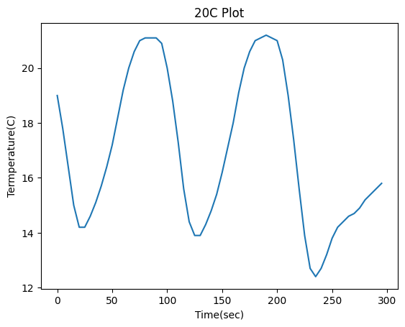
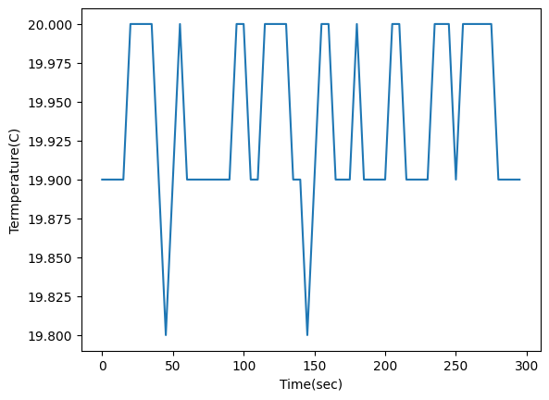
Accomplished Projects
2. Temperature Chamber
Before
After
Notes:
Before and After, at 20C
Move to the third projects

Slide 15
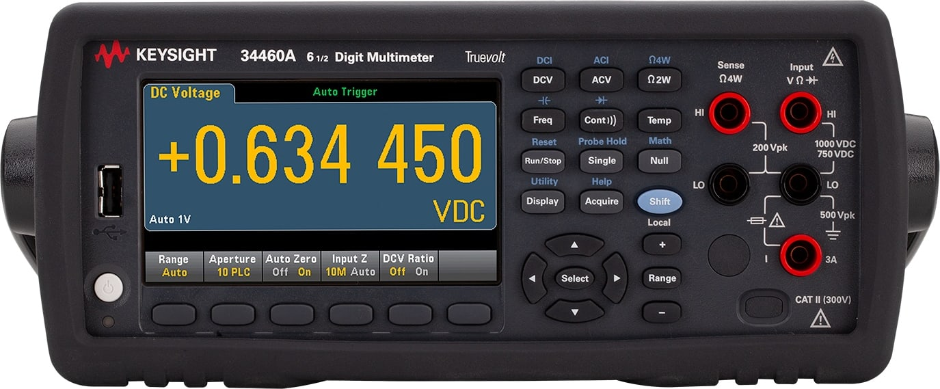
Accomplished Projects
3. Digital Multimeter
The Problem? Why?
Read Temperature from DMM
Different Models support different Thermo Probes
Notes:
DMM
Read Temperature
Different Thermo Probes

Slide 16
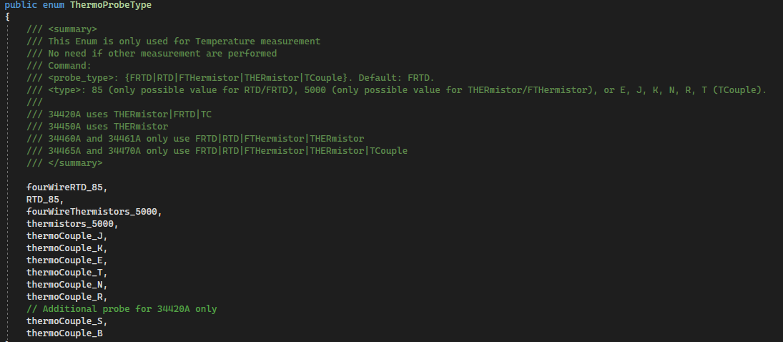
Accomplished Projects
3. Digital Multimeter
The Solution -> How !?:
Read Temperature from DMM
Create GetTemperature() Function in C#
Different Models support different Thermo Probes
“Switch” Statement to choose ThermoProbe for different models
Notes:
Solution in software:
This is all the project I have finished during this internships.
I learned lots of things!

Slide 17
Key takeaways
Be Proactive
Take the Responsibility
Try First
One Problem/Thing at a time
Be Precise/Easy to Understand
Notes:
Talk more, don’t be shy, ask for help when I am not capable of doing sth. Beyond my understanding
Take responsibility for your projects. My duty is to fix the bugs, worry about the end-user experience, etc. Don’t be someone who just follows other’s minds. Think independently
Always try first! That’s how I learned the knowledge. Give a shot, and how I get the practice
Easiest way to find the problem/cause, and solve the bug
How to let someone understand what you’re doing without online research. How to make the product user-friendly. No confusion to use

Slide 18
What skills do I learned
C#
GitHub
Python Programming Practice
Instrument Interface
Batch Script
Notes:
Skills:
New Programming Languages
Learned a lot using this, compare to school.. Nothing
Lots of practice using programming
Instrument interface
Batch script to semi-auto install software.

Slide 19
Acknowledgment
Shawn
Julio
Tanner
Angel
Jason
Hala
Eridan
Notes:
For great-support along the way, lead me to think about the problem, marketing requirement, and how to make code/project easier and more precise when doing code review
For great-help when I was doing all software stuffs, Gained lots of help when developed the pyEridanLab. And appreciate some life/work lectures he told me
For great-help when I was doing all hardware stuffs, Always happy to help, show me where to find the stuffs. And happy to explain what’s going in the hardware.
Give my respect to you when we were doing the code review, you were being really details-oriented. Spent half-hours to put comments on the little things
Give my respect to your work-ethics. Always focus on the work, and being professional
For great-help about how to get involved within the company since the first day I came here.
Thanks for giving me the opportunity doing my first internship here. It has a great company-culture, met lots of great people who know a lot about everything. Hope to see the day when Eridan goes to public

Slide 20

Q&A

